Slide 1
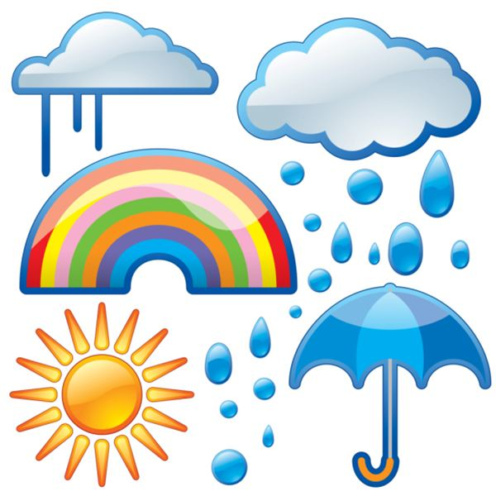
Climate Change
Lesson # 1 – Weather & Climate
(7.1 of Textbook)

Slide 2
Weather vs. Climate
Weather
Atmospheric conditions including temperature, precipitation, wind, and humidity, in a particular location over a short period of time, such as a day or a week.
Climate
The average of the weather in a region over a long period of time.
To determine climate, climatologists collect weather measurements made over 30 years or more and average the results.
“Climate is what you expect, but weather is what you get” – Robert Heinlein.

Slide 3
Weather vs. Climate Analogy
Think of all the clothes in your closet. Your entire wardrobe is dictated by the climate of Ontario, but your outfit today is determined by the weather.

Slide 4
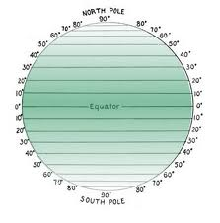
How Is Climate Affected?
Latitude

Slide 5
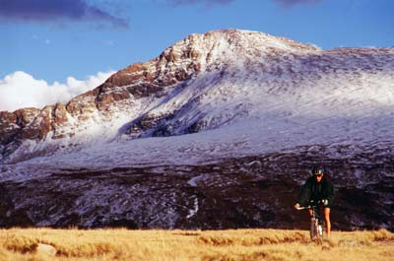
How Is Climate Affected?
2. Elevation

Slide 6
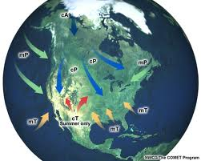
How Is Climate Affected?
3. Air Masses

Slide 7
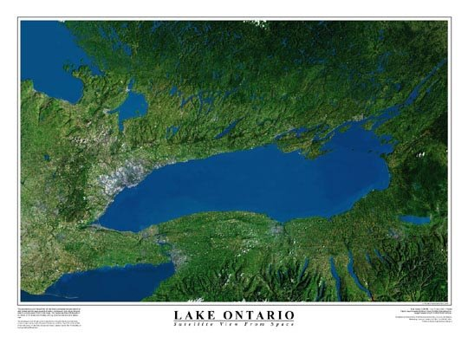
How Is Climate Affected?
4. Proximity to Water

Slide 8
The Sun
The amount of energy in a region, also known as solar radiation, determines the weather and climate of a region.
Solar radiation is a wave of energy received from the sun. Some energy is absorbed and converted to thermal energy (heat).
The closer you are to the equator, the more direct solar radiation you receive. When you move north or south of the equator, your amount of radiation depends on the time of year and rotation of the earth.

Slide 9
Solar Radiation

Slide 10
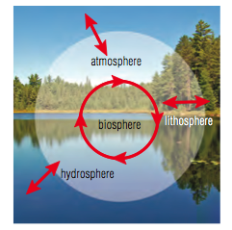
Earth’s Biosphere
The biosphere is the layer of Earth that has conditions suitable for supporting life. It is a relatively small portion of the entire Earth.
It consists of three parts:
The atmosphere (the air)
The lithosphere (the land)
The hydrosphere (the water)

Slide 11
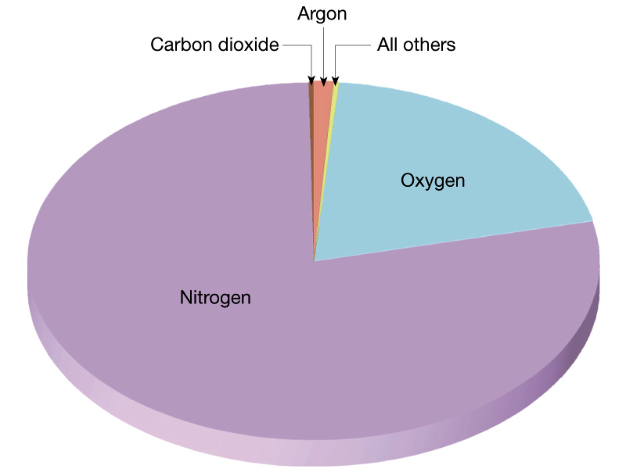
The Atmosphere
Our atmosphere extends about 300 km above the Earth’s surface.
Air is a mixture of gases, mainly nitrogen, oxygen, but with small amounts of argon, carbon dioxide, neon, helium, methane, and krypton.

Slide 12
Layers of the Atmosphere
We live in the troposphere, where there is plentiful oxygen. It is also where all the day to day weather occurs.
Above the troposphere is the stratosphere, commonly called the “ozone layer”, as oxygen is mainly in the form of ozone, O₃, which is a very reactive form of oxygen, which can absorb ultraviolet radiation from the sun.
The next layer is the mesosphere, where there is very little gas and the air is thin.
The final layer is the thermosphere, where again there is very little gas, but the temperature is warmer due to high energy particle reactions. This is also where the auroras occur “northern and southern lights”.
Beyond our atmopshere is the exosphere, or “outer space”!

Slide 13
Atmospheric Layers

Slide 14
The Lithosphere
The lithosphere extends from the outer surface of the Earth (the crust) down as much as 5 km below oceans and 100 km below the continents (the mantle).
Only the top layer is warmed by solar radiation, and the rest by radioactive decay of elements that exist in the mantle.
The movement of tectonic plates affects climate because as they collide, they push up mountains, which changes elevation and weather patterns.

Slide 15
Lithosphere & Climate

Slide 16
The Hydrosphere
The hydrosphere consists of all the water on the Earth, including fresh and salt water.
Fresh water is only about 3% of all the water on Earth, and it is contained in groundwater, lakes, streams, snow, and glaciers.
The other 97% of water is in the oceans, and is undrinkable.
The water cycle plays a large part in weather patterns and long-term climate predictions.

Slide 18
Biosphere Interactions
Example: water is present as water vapour in the atmosphere, where it plays a role in cloud formation and precipitation. It is also present in the soil and minerals of the lithosphere, where it erodes the rock and dissolves salts that plants can use as nutrients.
Because these interactions are continuously changing, so Earth is said to be dynamic.

Slide 19
Biomes
You learned in grade nine that a biome is a large geographical region with a defined range of temperature and precipitation – its climate.
Each biome is characterized by the plants and animals that are adapted to that climate.
Canadian Biomes:
Tundra
Boreal Forest (taiga)
Temperature Deciduous Forest
Temperate Grasslands
Temperate Coniferous Forest
Mountains

Slide 20
Homework
Textbook Page 273 # 1-7, 9, 10, 12, 14-16
Weather or Climate? Worksheet

