Slide 1
Climate Change
Lesson # 7 – Action on Climate Change (9.2 of Textbook)

Slide 2
Mitigation
Making something milder or less severe
We are now thinking mitigation because we can’t just get rid of GHGs that are already in our atmosphere.
Ways to mitigate:
Renewable resources
Reducing fossil fuel and electricity consumption
Sequestering CO₂
Carbon offsets, emissions trading, carbon tax

Slide 3
Renewable Resources
Small wind farms with 45 turbines can generate enough electricity for 400 homes.
Solar panels are not installed in many new homes if desired.
Niagara Falls is a large hydro dam that generates electricity from falling water
Ocean tides are being looked into on the East and West coasts.
Electric or hybrid cars
What are the issues concerning each of these types of resources?

Slide 4
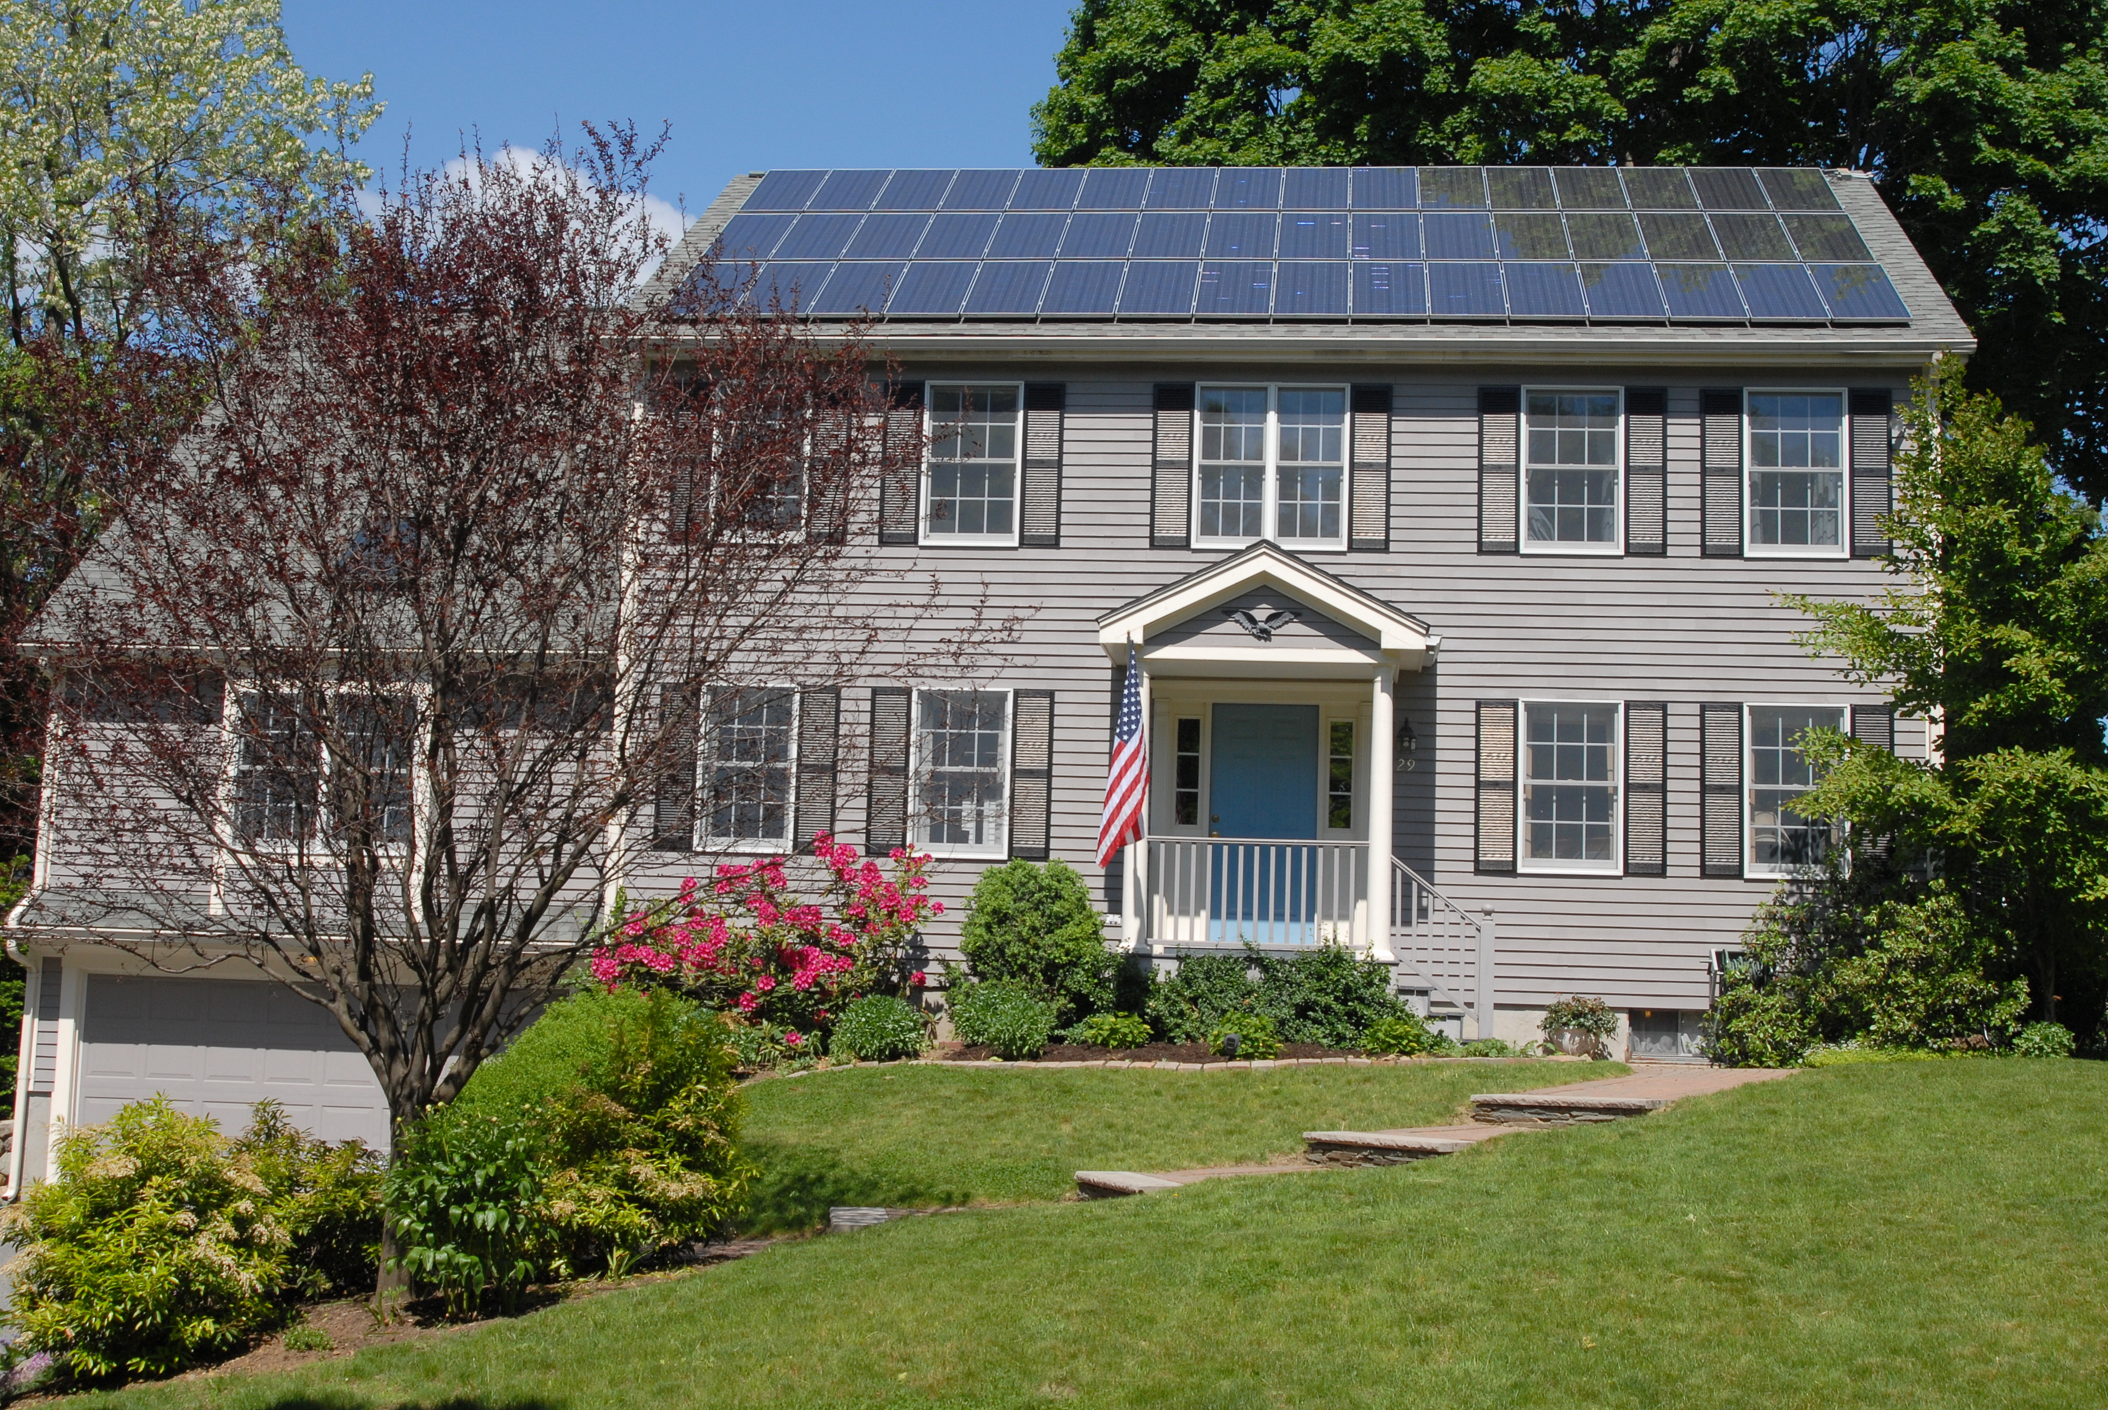
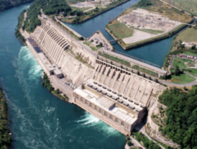
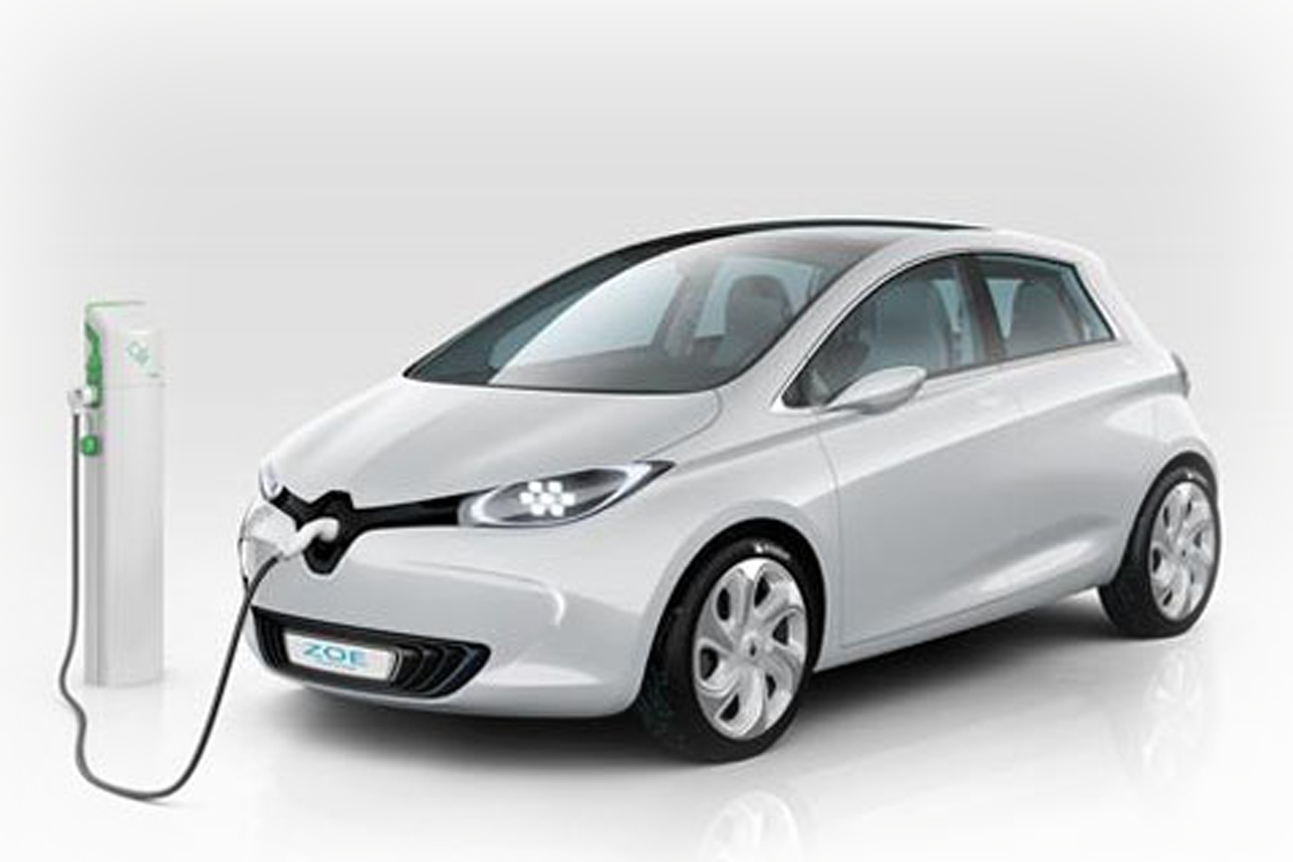
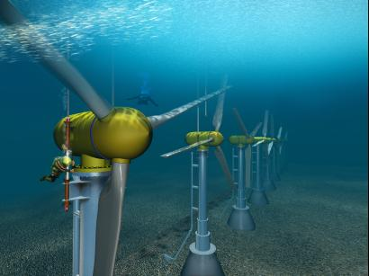

Slide 5
Reducing Electricity and Fossil Fuel Consumption
Energy efficient appliances
Hang-dry clothing in warmer weather
Open windows and use fans in summer
Windows that reflect more light
Nuclear over coal power plants
Carpooling and biking

Slide 6
Sequestering Carbon Dioxide
Plants, soil, oceans can act as carbon sinks and sequester (store permanently) carbon dioxide.
Right now human-made carbon sequestering areas would be expensive and require large amounts of energy.
How do you think we could store more carbon in nature?

Slide 8
Carbon Offsets, Emissions Trading, Carbon Tax
Carbon offsets can be purchased by companies to improve their carbon footprint. If they contribute money to improve a carbon sink, then their company can still produce GHG emissions.
Emissions trading can be done if a company does not use its maximum carbon allowance. They can sell their extra to another company who produces more.
Carbon taxes are common now to any company that produces GHG emissions. They money is used to mitigate pollution or help with climate change initiatives.
What are the pros and cons to these methods?

Slide 9
Adapting to Climate Change
Though ideally we would like to STOP climate change, we know that even with slowing it we still must adapt to the changes from the greenhouse gases already in the atmosphere. So what do we do?
Look at table 9.3 on page 355 of textbook. What issues do you think will be of biggest concern in the future? The least?
What countries do you think have the best adaptive capacity to climate change? Why?

Slide 10
Homework
Pg. 360 # 1-5, 7-12, 14-16
Read “Human Volcano” on page 361
Videos:
Adapting to Climate Change

