Slide 1
Climate Change
Lesson # 3: The Anthropogenic Greenhouse Effect
(8.1 of Textbook)

Slide 2
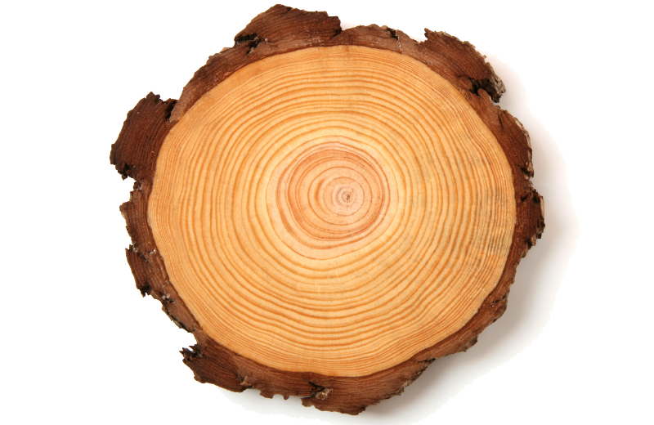
Determining Past Climate
Tree Rings – scientists analyze the thickness of tree rings to determine the growing conditions that year.
A thicker ring means better conditions - enough precipitation and appropriate temperature.
A thin tree ring could mean drought, or higher or lower than average temperature.

Slide 3
Determining Past Climate
Ice Cores – scientist drill deep down into glaciers and extract a cylinder of snow and ice from up to 200 000 years of icefall.
Each layer looks unique, and scientists separate each layer and melt it separately, then analyze for dissolved gases
Scientists have concluded that around the year 1750, the same time as the start of the Industrial Revolution, carbon dioxide concentrations began to rapidly increase in the ice core samples.

Slide 4
Ice Cores

Slide 5
Greenhouse Gases
A reminder that water vapour, carbon dioxide, methane, and nitrous oxide are all natural greenhouse gases. They help keep our Earth at a livable temperature – the natural greenhouse effect.
Global warming potential measures the ability of a gas to trap thermal energy in the atmosphere over a specified time.
Persistence is the length of time the gas remains in the atmosphere. The longer it remains, the longer it will be able to absorb thermal energy.
Nitrous oxide has the greatest potential and persistence, then methane, while carbon dioxide has the least. Water vapour is typically not included as its data varies with temperature.

Slide 6
Greenhouse Gas Concentrations
From ice-core sampling and atmospheric data gathered over the last 40 years, climatologists have been able to conclude that greenhouse gas concentrations have increased since the 1700s. What occurred during this time?
Since the natural water, carbon, and nitrogen cycles have not changed, the concentrations of greenhouse gases in the atmosphere must have appeared due to human activities.
The additional greenhouse gas emissions from human activities leads to the anthropogenic greenhouse effect (an enhanced version of the natural one)

Slide 7
Greenhouse Gas Emissions

Slide 8
Sources of Carbon Dioxide
Any process that releases carbon dioxide into the atmosphere is called a carbon source.
Burning fossil fuels (coal, oil, gasoline, natural gas)
Making cement
Deforestation
Any process that removes it from the atmosphere and stores it is called a carbon sink.
Photosynthesis
Dissolved CO₂ in oceans and lakes
Trees act as both a carbon source (they are made of it) and a carbon sink (they store it during photosynthesis). Cutting trees down destroys the sink and releases the stored CO₂ to the atmosphere.

Slide 9
Sources of Methane & Nitrous Oxide
Methane
Coal mining
Production of petroleum products
Natural gas leaks
Rice paddies, landfills, cattle
Nitrous Oxide
Burning coal, oil, gasoline and natural gas
Fertilizer

Slide 10
Global Warming vs. Climate Change
Global warming is the observed increase in the Earth’s average annual temperature.
Climate Change is the significant long-term change in climate
Temperature
Precipitation (contributing to floods and droughts too)
Number and severity of storms
Strength of winds
Put in order: climate change, anthropogenic greenhouse effect, global warming

Slide 12
Now What?
Now that we know climate change is indeed happening due to human activities, what do we do about it?
The Intergovernmental Panel on Climate Change (IPCC) is a group of many countries trying to solve the climate problem.
This needs to be a global effort. Why???
Make a list of human activities that contribute to climate change. *check out page 305 if you’re stuck*

Slide 13
Homework
Page 307 # 1-8, 10-13, 15-17
Watch Video “the story of stuff” athttp://storyofstuff.org/movies/ - scroll down to select the correct video.

