Slide 1
Climate Change
Lesson # 6 – The Future of Climate Change (9.1 of Textbook)

Slide 2
Computer Models
Climate scientists use computer models to predict future climate.
The models use complex mathematical equations that describe interactions in the physics, biology, and chemistry of the Earth’s climate system.
From this data they create predictions of future climate.
The models are only accepted if they can accurately predict the past and compared to accepted knowledge of past climate.

Slide 3
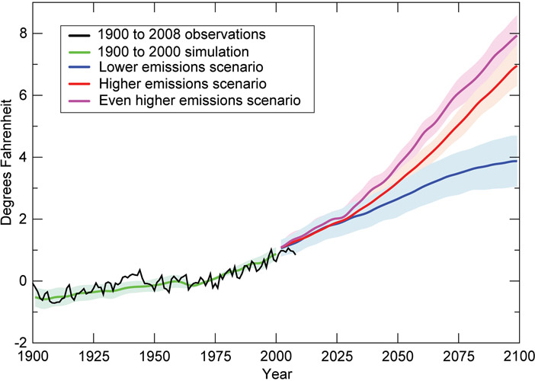
Computer Models
In the most reliable models, it is show that the Earth will continue to warm and climate will then continue to change if we continue our output of greenhouse gas emissions.

Slide 4
Aerosol Pollution
Aerosols (from spray bottles, paints, etc.) mask the severity of global warming.
Aerosols have a cooling effect on the atmosphere (they reflect solar radiation), so without their use, Earth’s temperatures would actually be even warmer.
So why don’t we just spray a whole bunch of aerosols into our atmosphere to block out the radiation???

Slide 5
Confidence Ratings on Data
Every model and information gathered by scientists on climate change is given a confidence level.
It is a rating scale from 0-100% that provides confidence that the data is accurate.
Higher confidence levels go to scientists with:
More data (long-term)
More accurate measurements (with multiple scenarios)
Greater understanding of factors involved in climatic events

Slide 6
Political Action on Climate Change
UNFCCC
United Nations Framework Convention on Climate Change – started in 1992.
192 countries involved in stabilizing greenhouse gas emissions to a level that would prevent dangerous anthropogenic interference with the climate system.
Sustainable development – use of the world’s resources in ways that maintain these resources for future generations – is a key area of focus.
In Canada, we selectively cut forests to keep carbon sinks intact, maintain ecosystems and ensure forestry still exists in the future.

Slide 7
Political Action on Climate Change
Kyoto Protocol & Copenhagen Accord
161 countries of the UNFCCC met in Kyoto, Japan in 1997 and agreed to reduce GHG emissions – a legally binding document. Canada’s goal was reduction of 6% by 2012.
Between then and 2008, Canada actually increased GHG emissions by 24%!
Since then, Canada has opted out of the Kyoto Protocol and signed the Copenhagen Accord, which is not legally binding.
Canada is to reduce GHG emissions by 17% from the 2005 level by the year 2020.

Slide 8
Emission-Reduction Credits
Part of the Kyoto Protocol was to give credits to countries for actions that contribute to the GLOBAL reduction of GHG emissions, if not in their own country.
This helps developing countries to reduce their emissions when they may not have the resources or means to do it on their own.
Helping with tree planting overseas or helping another country in event of a natural disaster are all ways a country can get emission-reduction credits.

Slide 9
National & Provincial Action
Kyoto and Copenhagen were international agreements.
We also have in-country initiatives.
Looking into the Alberta Oil Sands, XL Keystone Pipeline, Ethanol Use, Deforestation, and GMOs will be some of the national interests covered in your culminating debate.
Ontario also has the “Go Green” plan to reduce emissions, improve transit, encourage green technology, use renewable energy sources, and protect green spaces and farmlands.

Slide 10
Homework
Page 347 # 1-4, 6, 8-11bc, 12-14
Videos:
Taking the Earth’s Temperature – Climate Models

